Slide 1
Minimum Cost Path
-20BCE1865, AHILAN A

Slide 2
Problem statement:
Given a cost matrix cost[][] and a position (m, n) in cost[][], write a function that returns cost of minimum cost path to reach (m, n) from (0, 0). Each cell of the matrix represents a cost to traverse through that cell.

Slide 3
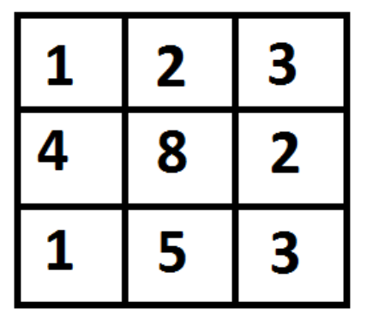
Given a cost matrix cost[][] and a position (m, n) in cost[][], write a function that returns cost of mum cost path to reach (m, n) from (0, 0).

Slide 4
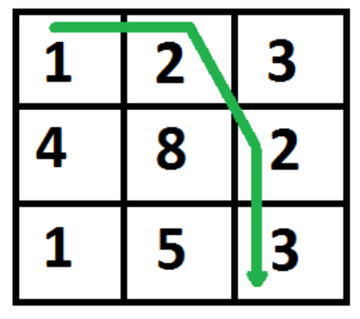

Slide 5
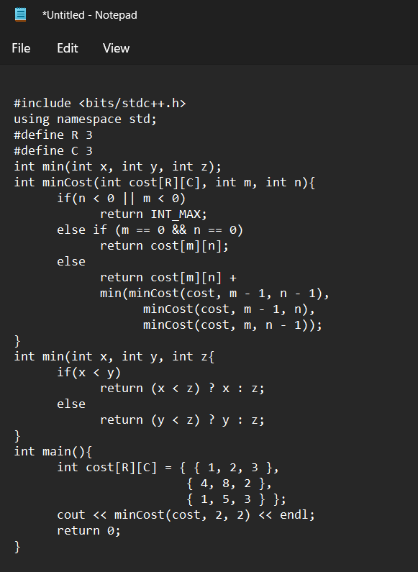
Naive method:

Slide 6
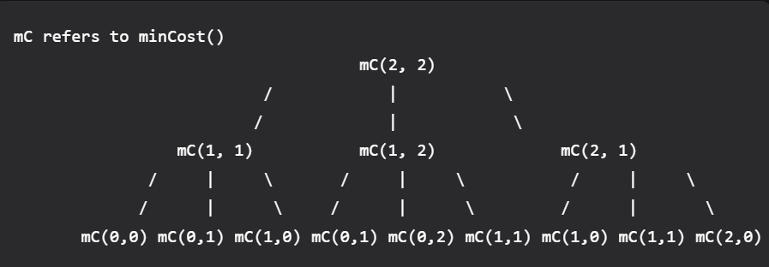
Recurssion Tree:

Slide 7
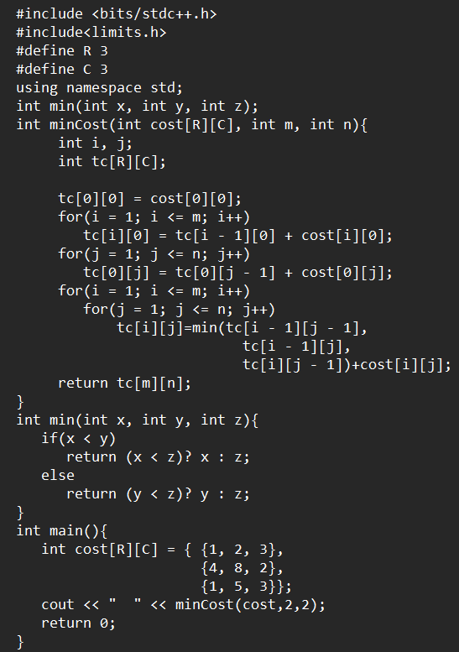
Dynamic approach:

Slide 8
Thank You

